Slide 1
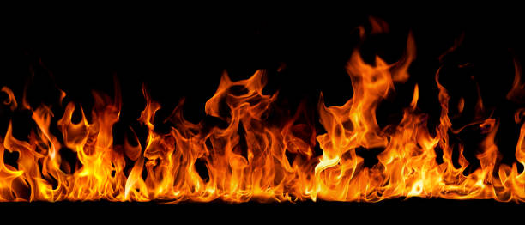
Fire detection camera using Image Processing
GROUP - 2
Notes:
Our project notes here...

Slide 2

Members:
Soubhik Chaki(1704225)
Sneha Kundu(1704224)
Sounak Sinha(1704228)
Swardhya Dey(1704229)
Subhodeep Sinha(1704230)
Notes:
Members

Slide 3
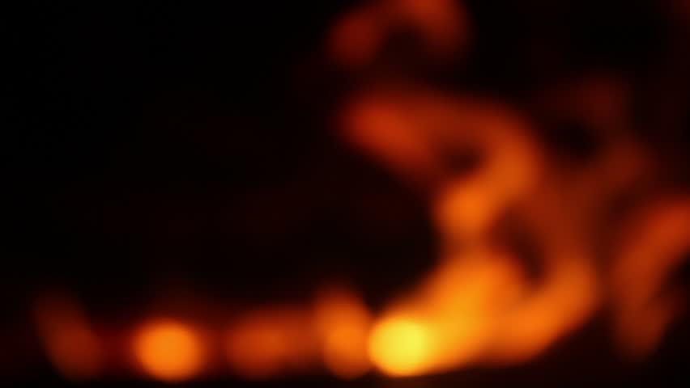
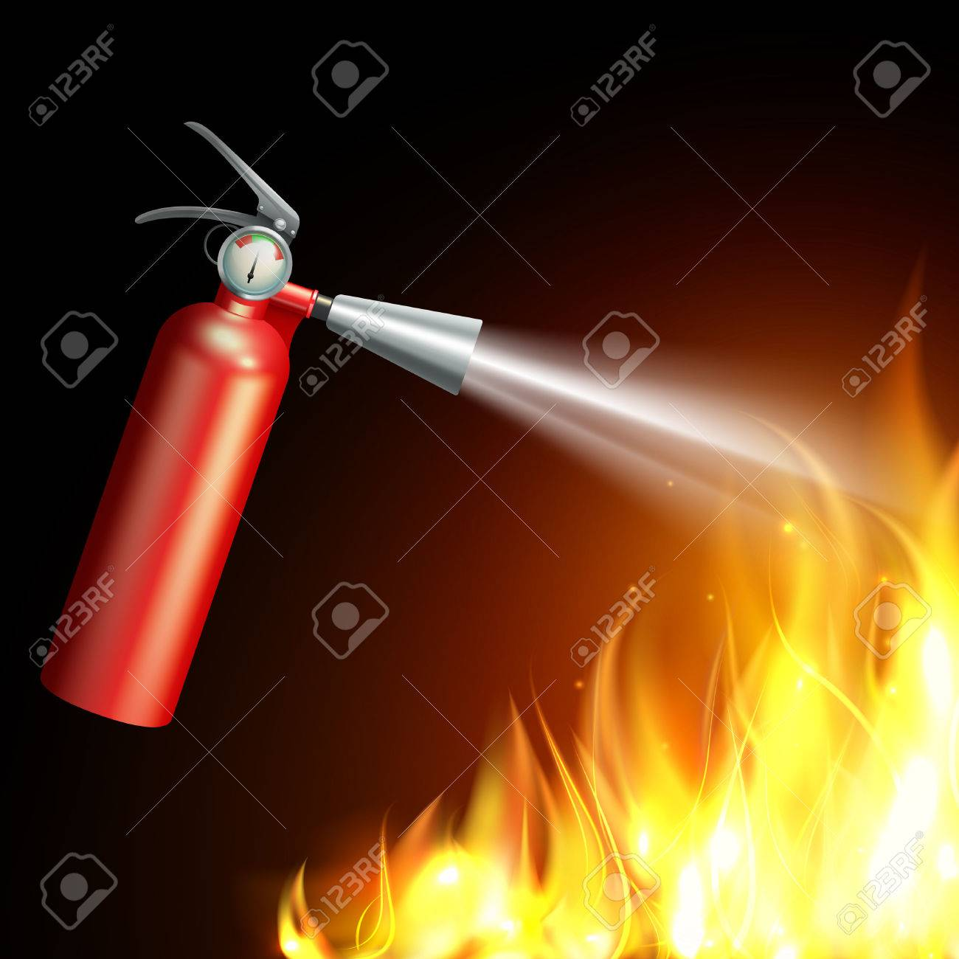
LIFE IS TOO SHORT TO GET BURNED!!!
SAFETY
Fire extinguisher :
a device used to extinguish or control small fires, often in emergency situations.
considered a common safety precaution
Water, Carbon dioxide, AFF foam,water mist, etc.
Notes:
Why Safety? Because life is too short to get burned. Safety available to us so far fire extinguisher

Slide 4
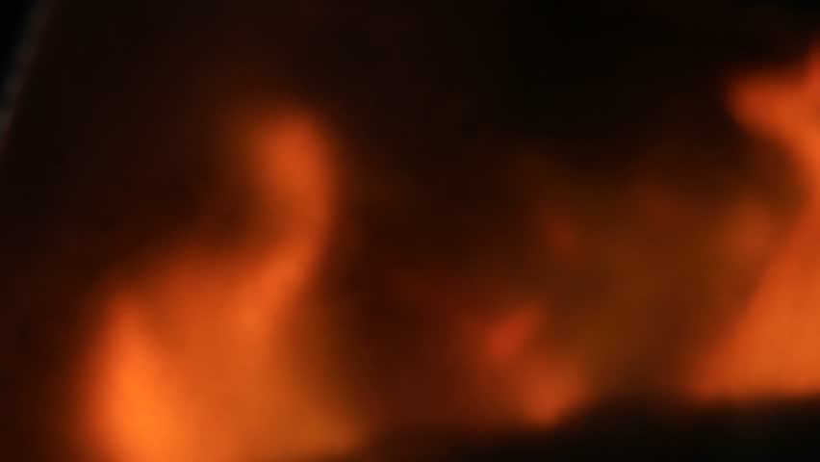

A Fire EXIT:
A special kind of emergency exit, usually mounted to the outside of a building or occasionally inside but separate from the main areas of the building
Notes:
fire exit..etc etc. Above all, What we believe is..... (NEXT SLIDE)

Slide 5
The best PROTECTION is early DETECTION!!!
Before extinguishing
DETECTION
Comes
Notes:
Before extinguishing or using fire exits, comes DETECTION.

Slide 6
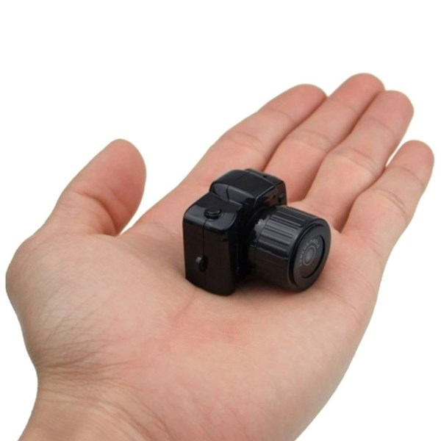
OUR PROJECT
Program to detect fire
A LIFE SAVIOUR
Notes:
what are we focussing on? In making A life savior

Slide 7
BASIC ALGORITHM:
CAPTURE
STORE
COMPARE
Notes:
Basic algorithm has three phase: Capture then store, then compare and ......(Next slide)

Slide 8
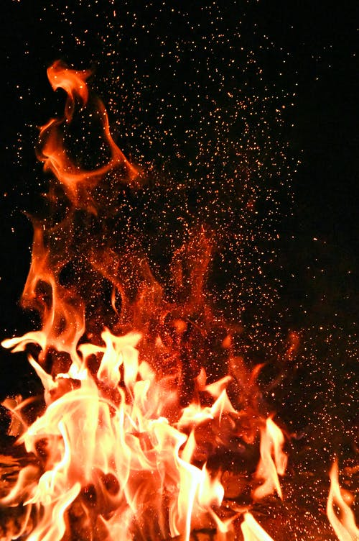

WORKING:
img = cv2.cvtColor(frame, cv2.COLOR_BGR2HSV)
lower_range = np.array([0,10,200])
upper_range = np.array([34,88,226])
mask =cv2.inRange(img, lower_range, upper_range)
BGR Image
HSV Image
Converts

Slide 9
Capturing Real fire
while True:
count +=1
= outpath='D:\Image_processing\output\\user'+str(count)+'.jpg'
cv2.imwrite(file_path,mask)
if
break
BGR to HSV code
Storage path
file_path
count==100:
Captures 100 samples/interval

Slide 10







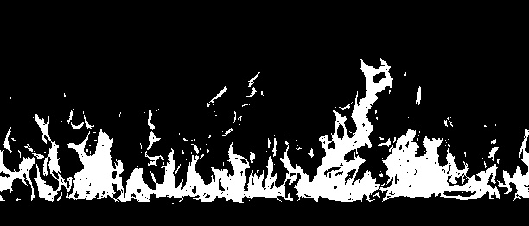
COMPARE
Stock Photos
Camera Photos

Slide 11
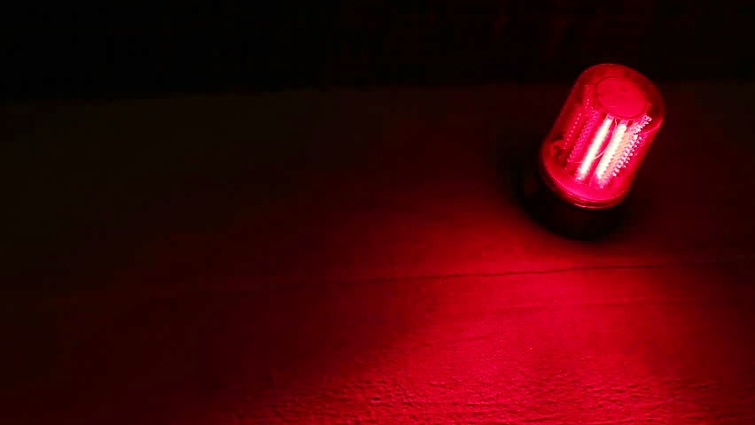
Then!!!
ALERT!!!
Notes:
Finally Alert if any fire takes place

Slide 12
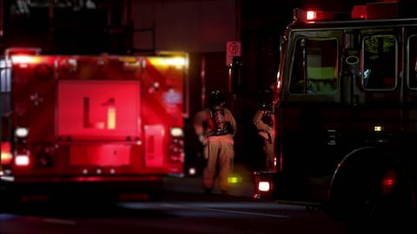
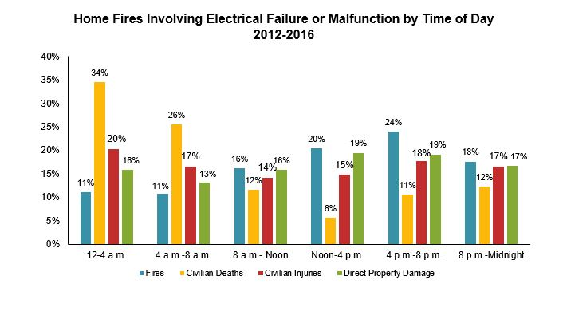
Statistics:
Source: www.nfpa.org\News-and-Research/Data-research

Slide 13

Significance
Prior detection:
Alerts civilians
101 call
More escape time

Slide 14
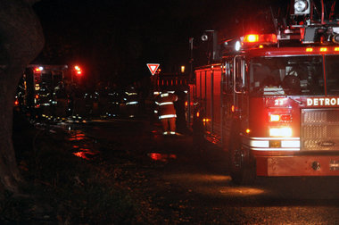
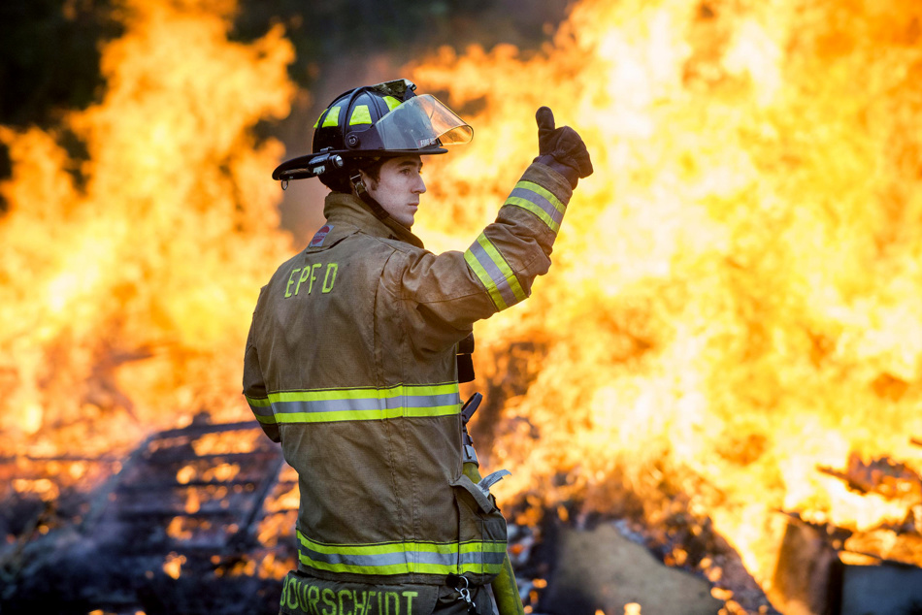
Finally yet IMPORTANTLY
CALL 101
AND
STAY SAFE!

